Slide 1
AI & Machine Learning
PART A: CLASSIFICATION
By: Yek Yi Wei (p2107631)

Slide 2
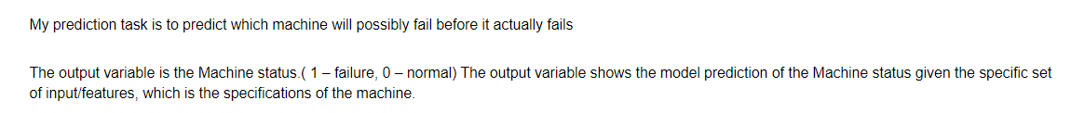
Prediction of Factory Machine/Component Failure

Slide 3
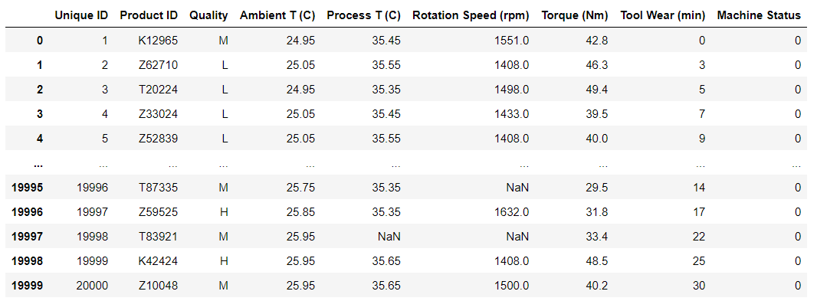
Default Dataset: factory_data.csv

Slide 4
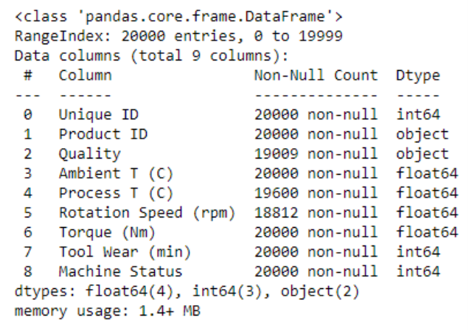
Missing values & features
Features with Missing values – Quality, Process, Rotation Speed

Slide 5
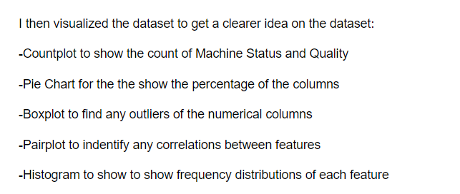
Data Exploration

Slide 6
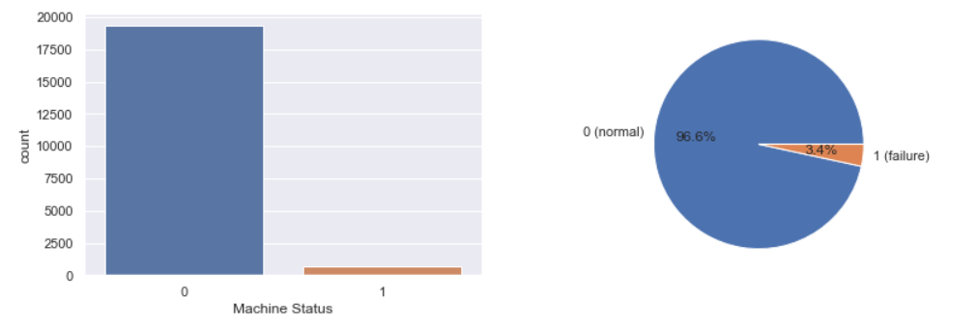
Data Exploration- countplot, piechart
Machine Status

Slide 7
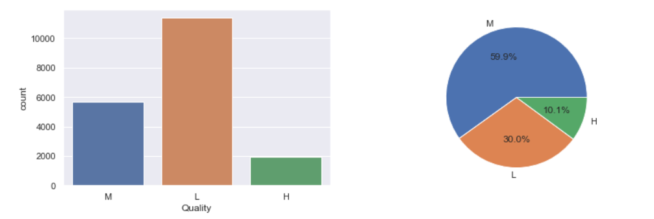
Data Exploration- countplot, piechart
Quality

Slide 8
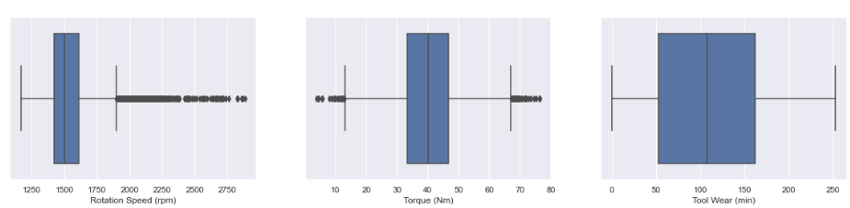
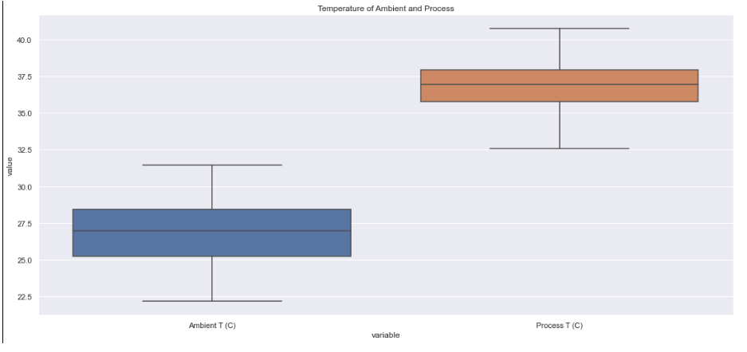
Data Exploration- Boxplot

Slide 9
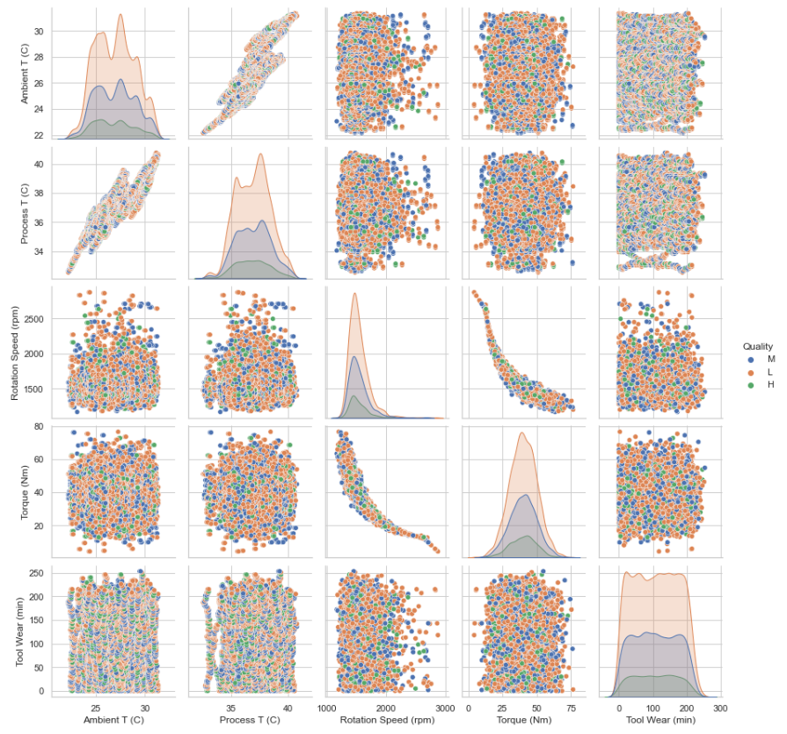
Data visualization – pair-plots
Positive correlation between
Ambient & Process
Negative correlation between
Rotation Speed & Torque

Slide 10
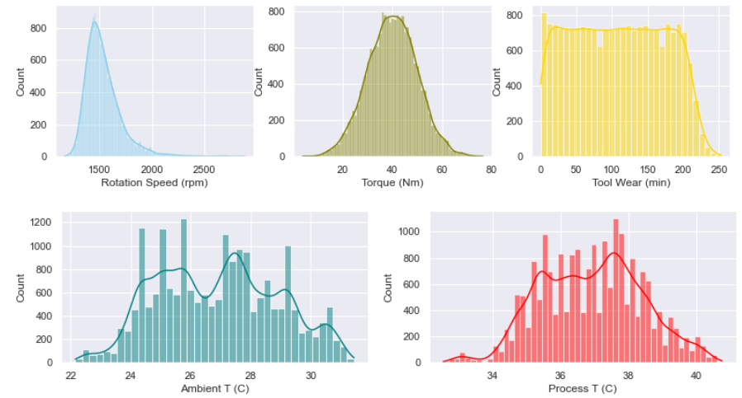
Data visualization – Histogram
Rotation & Torque are approximately normal distributed (Bell shape)
Tool Wear is uniformly distributed
Bimodal
Multimodal

Slide 11
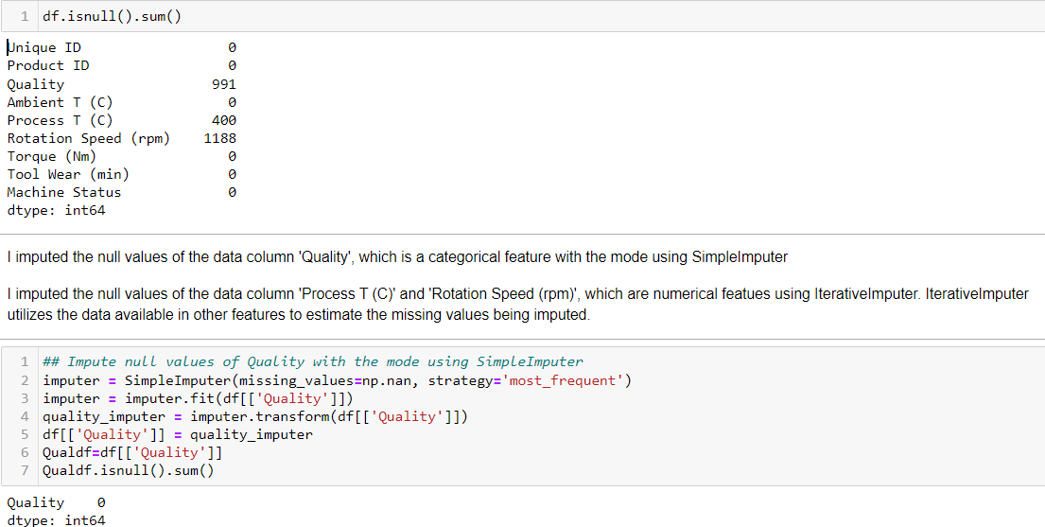
Data Processing
Before
After

Slide 12
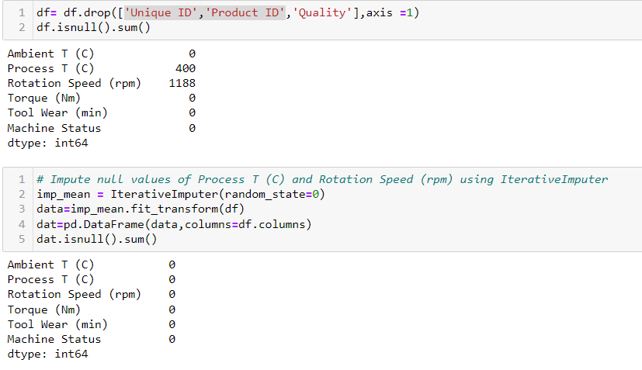
Data Processing
Before
After

Slide 13
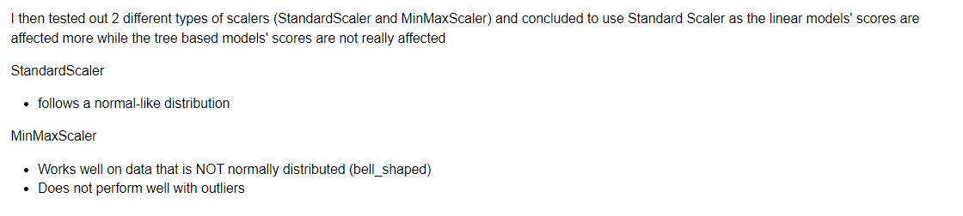
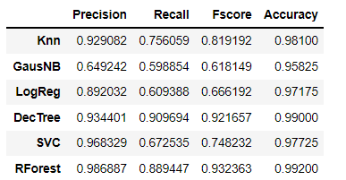
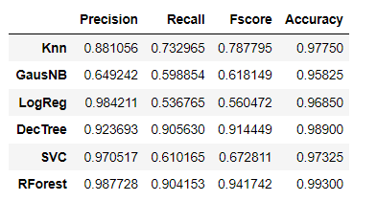
Scalers
StandardScaler
MinMaxScaler

Slide 14
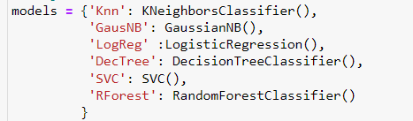
Models Used
KNN
GausNB
Logistics Regression
Decision Tree
SVC
Random Forest

Slide 15
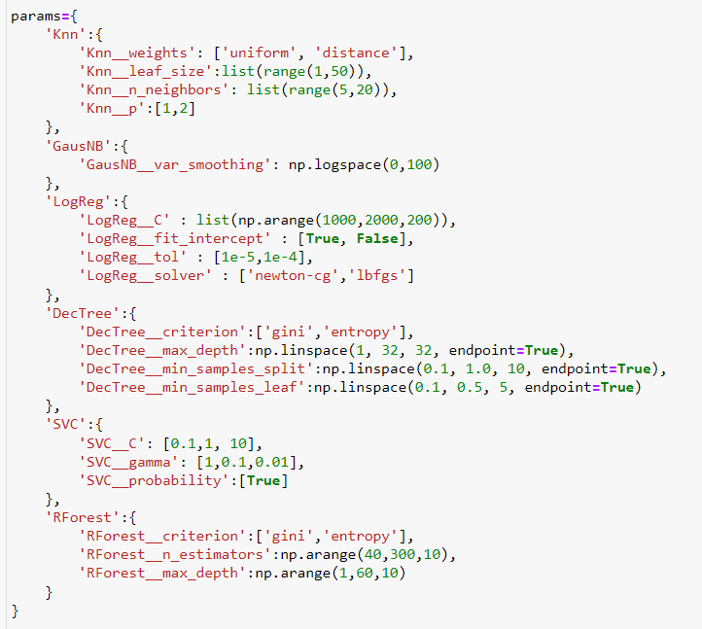
Model Selection & Hyperparameter Tuning

Slide 16
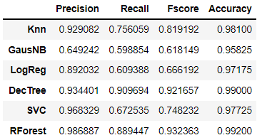
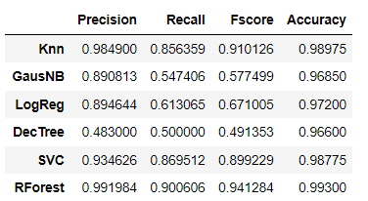
Performance Evaluation
Before Tuning
After Tuning

Slide 17
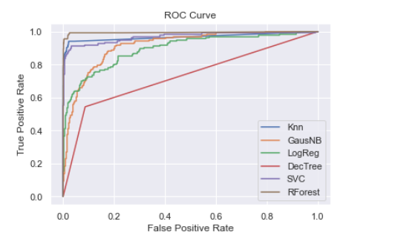
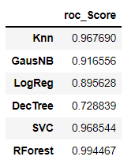
ROC curves
The ROC plot shows that the Randomforest provided the best performance as it occupies the curve at the far left and top, so the Area Under the curve is close to zero.

Slide 18
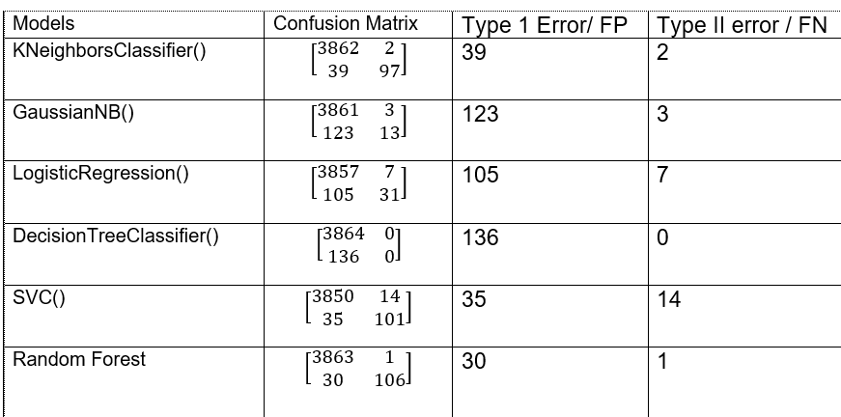
Errors made by the models
Random Forest has the lowest Type 1 error
Decision Tree has
Zero Type II Error

Slide 19
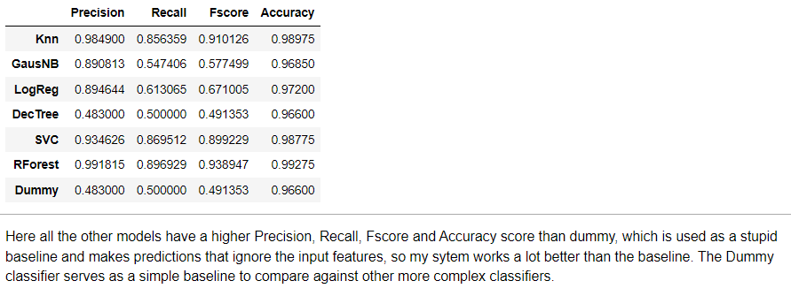
Comparison to a stupid baseline

Slide 20
Evaluation
Conclusion

